Slide 1
Session Plan
First half
Lecture recap
Bring me the news
Introduction to Levyne's spreadsheet model
Demonstration: How to use Levyne's spreadsheet model for your assignment
Second half
Worksheet
Worksheet check your answers

Slide 2
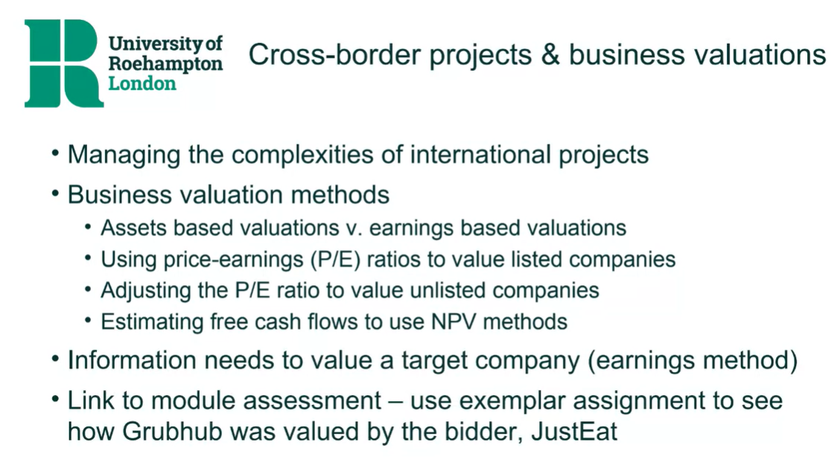
Week 4 Lecture recap

Slide 3
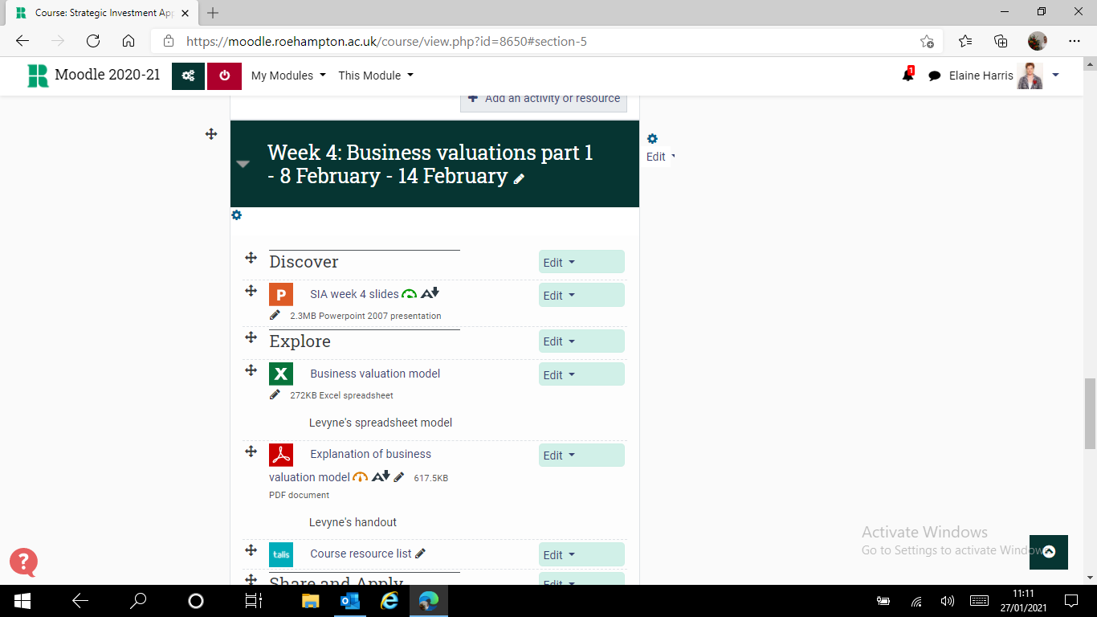
Where to find Levyne’s business valuation model to explore (download) & apply in the seminar

Slide 4
What makes up free cash flow (FCF) forecast in 2013-2015
Free cash flow (€ million) | 2013 | 2014 | 2015
Sales (revenue) | 1500 | 1800 | 2000
Growth rate (% ∆ in sales from previous year) | 25% | 20% | 11%
Earnings before interest, tax, dep’n & amort (EBITDA) | 400 | 420 | 450
EBITDA margin (% of sales) | 26.7% | 23.3% | 22.5%
Depreciation & amortisation (D&A related indirectly to sales) | (70) | (80) | (85)
Earnings before interest & tax (EBIT) | 330 | 340 | 365
Corporation Tax (36.1% of EBIT) | (119) | (123) | (132)
Net Operating Profit after tax (NOPAT) | 211 | 217 | 233
Depreciation & amortisation (D&A added back) | 70 | 80 | 85
Capital expenditure (CAPEX = real cash flow instead of D&A) | (70) | (75) | (80)
∆ Working capital (related indirectly to sales) | (50) | (50) | (50)
FREE CASH FLOW (profits available to owners) | 161 | 172 | 188
Notes:
Go to the Levyne’s business valuation model

Slide 5

Seminar Activity – share & apply open DCF step 1 tab in Excel
What is the NPV, business value?
What cost of capital has been used?
What happens to the NVP, business value if
The cost of capital is increased by 5%
The cost of capital is decreased by 5%
What is the sales revenue forecast for 2013 to 2015 and what is the growth perpetuity rate at the end of the forecast period 2021?
What is the EBITDA margin for 2013 & after?
What happens to the NVP, business value if
Growth rate in perpetuity is 5%
EBITDA margin is 5% less in 2013
Notes:
Demonstration

Slide 6
Levyne's model for DCF calculation for your assignment
Start by downloading the Levyne's spreadsheet model from week 4
You only need to open, copy and edit the tab labelled ‘DCF Step 1”
Notes:
Open new sheet
Enable editing
Select the whole sheet and Ctrl + C
Select A1 of the new sheet, Ctrl + V and Enter

Slide 7
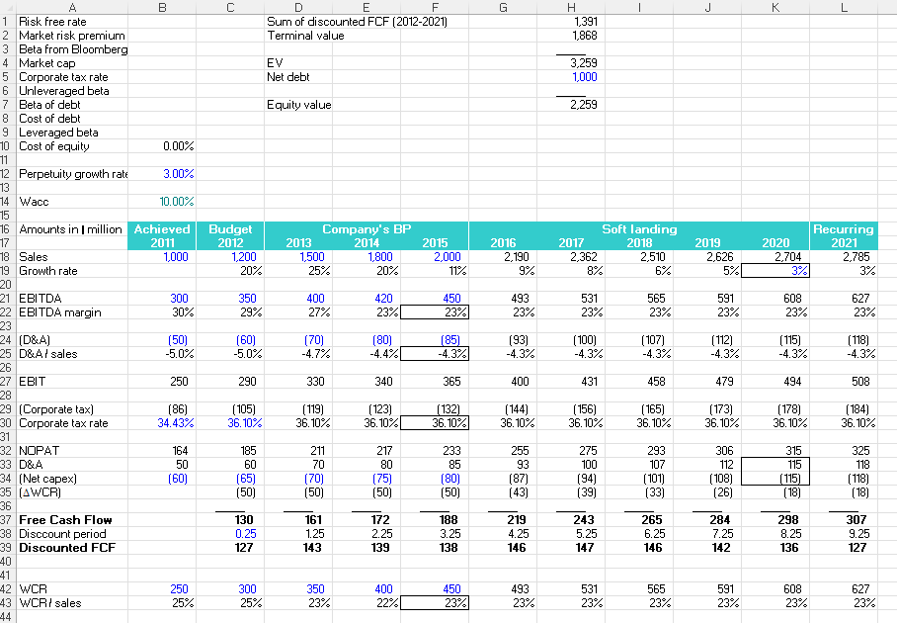
1.Componetnts for WACC
Three areas in “DCF Step 1” sheet
3. Final calculation
For your assignment: Try making your Equity Value as close to the bid price as possible, with realistic assumptions
2.Main table

Slide 8
Area 1: Components for WACC
WACC: Go to “DCF Step 2” sheet and take the formula (10% is just what Levyne has put in as just an example, so you need the formula to calculate WACC)
Components for WACC (Column B top left) may be googled – e.g. the beta value for the sector for B3 may be found on Betas (nyu.edu).
Show the URL where you have picked the information for instance in column J.
Cost of debt: Interest / long-term debt
Your WACC should be calculated in the feasible range between 5 to 10%.
Perpetuity growth rate: Make arbitrary assumption. You have actual growth rate from annual report from 2018,2019,2020
You don’t use market cap, unleveraged beta, beta of debt and leverage beta for this “DCF Step 1” sheet

Slide 9
Area 2: Main table
Use the latest annual report available for the target company at the time of the takeover bid to extract the data required for columns B, C & D and label them with dates of last 3 years’ results on row 17 and ‘Achieved’ on row 16, then use columns E to F for the ‘Forecast performance’ then use columns G to K for the ‘Soft landing’ (labelled as discount periods 1 to 8 in row 38). Accordingly, modify your discount period to be 0.0 in C38 and D38, then to be 1.0 in E38, 2.0 in E39, E39 in 3.0 and so on.
The cells in blue text are where you need to input data. Blue text is what Levyne has put in as example, so you need to input your data. Black text is formula.
Use your own assumptions to input the Sales, EBITDA, (net CAPEX), WCR in columns E to F
Remember any new owner would expect to be able to improve performance at least after the first 12 months

Slide 10
Area 3: Final calculation
Input the net debt
Label D1 as “Sum of discounted FCF (2018-2028)”
If your equity value in cell H7 is negative or way off the actual bid price, then check to make sure our free cash flows (row 37) are positive from at least one year in (column F). You should vary assumptions until the value in H7 gets close to the bid price, e.g. by increasing the sales growth or EBITDA% or by reducing the WACC to get a higher value, or the opposite to get a lower value.

Slide 11

Any questions? (on activities or the assessment brief)

